Slide 1

AI PROJECT (AI101B) II - Semester Session 2024-25 SALES DATA VISUALIZATION
Project Supervisor:
Ms. Komal salgotra
Assistant Professor
SAURABH KUMAR (202410116100188)
SATYJEET KUMAR (202410116100187)

Slide 2
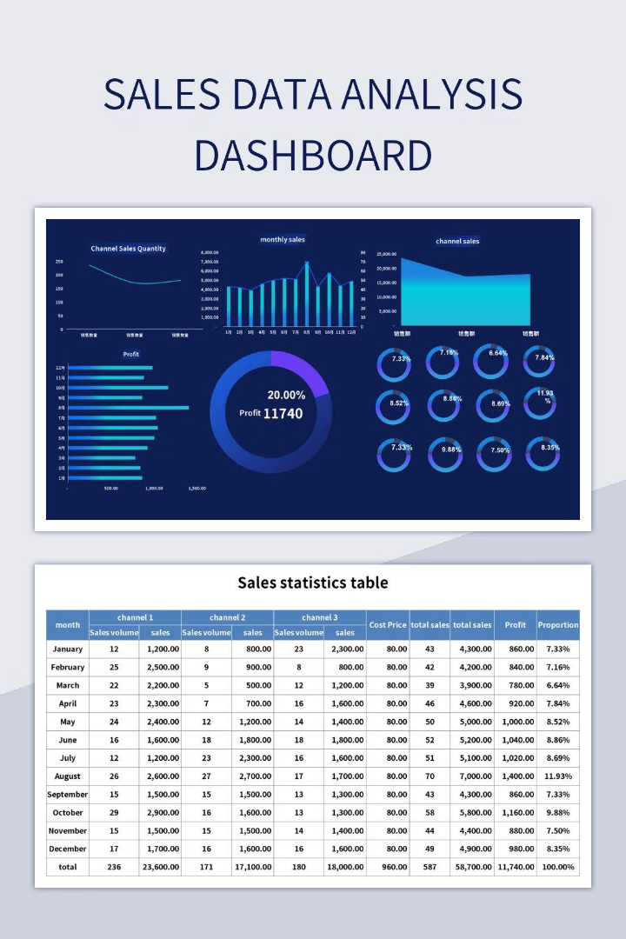
Sales Data Visualization
Problem Statement: In today’s competitive market, businesses generate huge volumes of sales data. The challenge is to extract meaningful insights from this data to make informed decisions.
Objective: The main goal of this project is to use Artificial Intelligence (AI) to automate the process of visualizing sales data, helping businesses to better understand trends, patterns, and anomalies.
Why AI for Sales Visualization?: AI can detect hidden patterns, make predictions, and generate interactive, insightful dashboards from large datasets, making it easier for businesses to drive decisions.
Platform: Google Colab is used as the platform for this project, providing an accessible environment to run machine learning models and visualize data interactively.

Slide 3

Introduction: Unlocking Sales Potential
The Challenge
Raw sales data is overwhelming and difficult to interpret.
The Solution
Interactive visualizations provide clear understanding.
Project Goal
Empower sales team with data-driven decisions.
Expected Outcome
Increase efficiency and improve sales strategies.

Slide 4
Methodology:
Data Collection
Data Preprocessing
AI Techniques
Visualization Design
The sales data used in this project is obtained from [source or dataset] and consists of various attributes such as product ID, date of sale, sales amount, region, and more.
Cleaning and normalizing the data.
Machine Learning models for predictions (e.g., sales forecasting).
Using libraries like Matplotlib, Seaborn, and Plotly, we create various types of visualizations including:
Handling missing values, outliers, and data imbalances.
Data visualization techniques such as heatmaps, scatter plots, and time-series analysis.
Line plots for sales over time.
Bar charts for regional sales comparisons.
Pie charts for product category distribution.
Heatmaps to visualize sales density by geographical location.
Interactive dashboards for user-friendly data exploration.

Slide 5
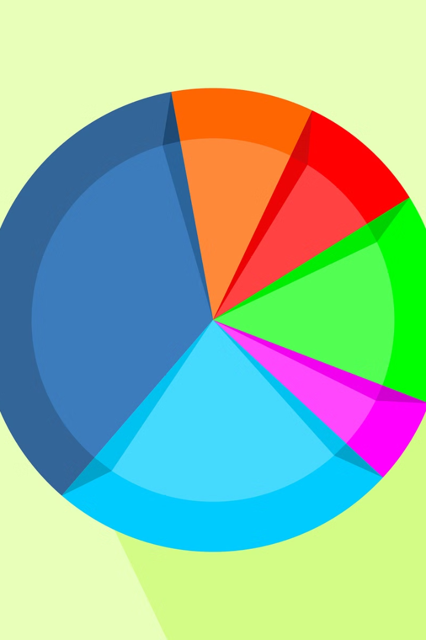




Key Visualizations & Insights
Sales
Customer Segmentation
Product Performance
Performance
Geographic Analysis
Example: The top 20% of customers generate 80% of revenue.

Slide 6

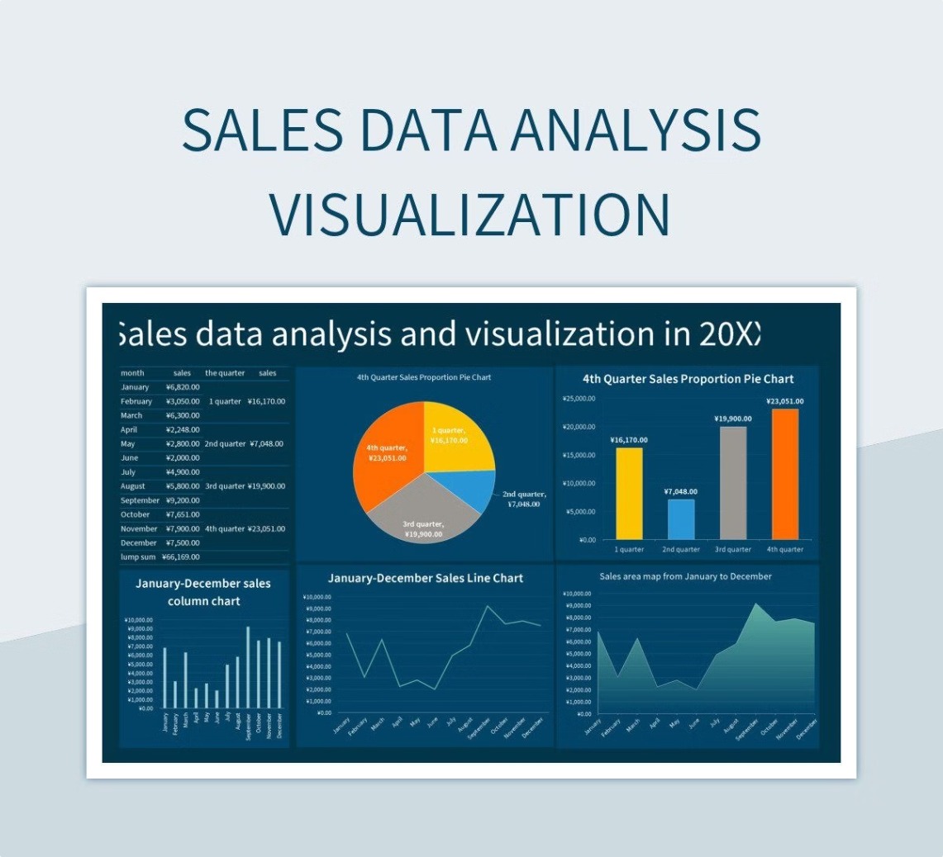
Project Timeline
1
Tools & Libraries Used
Python: Main programming language for data analysis.
Google Colab: Platform used for running the project and collaborating.
Pandas & NumPy: Data manipulation and preprocessing.
Matplotlib, Seaborn, Plotly: Data visualization.
Scikit-learn : For implementing any AI/ML models.
2
Data Preprocessing
Handling Missing Data
Data Transformation
Normalization/Standardization
3
Google Colab
Cloud-based, collaborative, and supports Python libraries like Pandas, Matplotlib, Seaborn, and TensorFlow for data analysis and AI.
4
Results and Insights
Key Findings from Visualizations:
Identifying best-selling products.
Seasonal sales fluctuations.
Predicting future sales trends and demand.
AI Model Results:
How well the model predicted sales data.
Performance metrics (R-squared, accuracy, etc.).

Slide 7


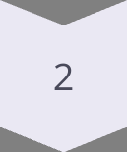

Conclusion: Data-Driven Sales Success
Recap
Project goals achieved actionable insights delivered.
Next Steps
Ongoing dashboard maintenance and enhancements.
In Conclusion
This project has provided valuable insights into our sales data. Based on the findings, we recommend focusing marketing efforts on underperforming regions and considering promotions for low-performing products. Additionally, the seasonal trends observed suggest that the company should plan its inventory and marketing strategies around Q4 to capitalize on increased demand.
Thank you!

